Slide 1
Foodie-fi Customer Data Analysis
Amina Javaid
3 December, 2023

Slide 2
Introduction
Foodie-fi is a new startup which started selling monthly and annual subscriptions to their customers giving them unlimited on-demand access to exclusive food videos from around the world.
This case study focuses on using subscription style digital data to answer important business questions.

Slide 3
Business Task
Improving customer retention to Foodie-fi subscriptions.

Slide 4
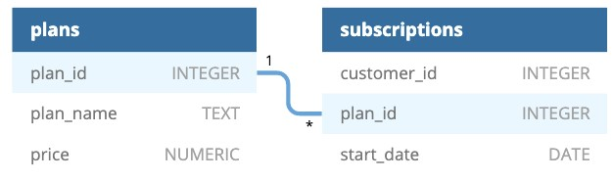
Data Source
All datasets exist within the foodie-fi database schema.
There are two tables in the schema:
plans
subscriptions

Slide 5


Data Processing
Create ‘foodie-fi’ schema in MySQL through provided SQL script.
Create tables ‘plans’ and ‘subscriptions’ in foodie-fi schema through provided SQL script.
Define ‘plan_id’ as Primary key in ‘plans’ table.
Define ‘plan_id’ as Foreign key in ‘subscriptions’ table.
Insert values into both tables through provided SQL script.

Slide 6

Data Analysis
Question 1. How many customers has Foodie-Fi ever had?
Query:
Result:

Slide 7
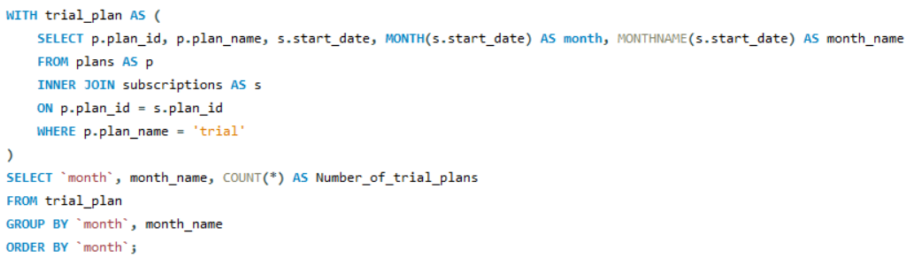
Data Analysis
Question 2. What is the monthly distribution of trial plan start_date values for our dataset? Use the start of the month as the group by value
Query:
Result:

Slide 8
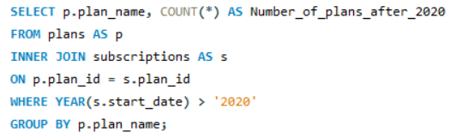
Data Analysis
Question 3. What plan start_date values occur after the year 2020 for our dataset? Show the breakdown by count of events for each plan_name.
Query:
Result:

Slide 9
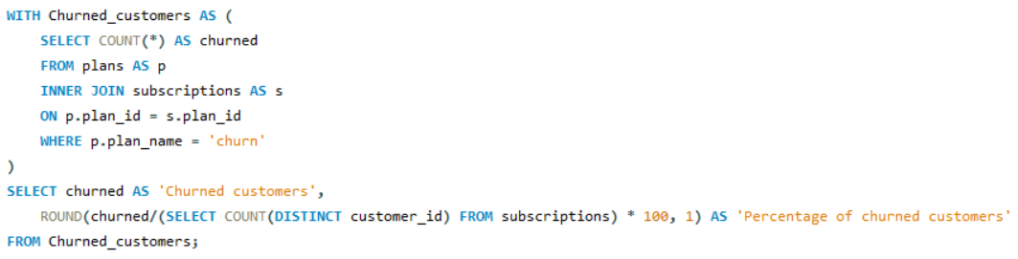
Data Analysis
Question 4. What is the customer count and percentage of customers who have churned rounded to 1 decimal place?
Query:
Result:

Slide 10
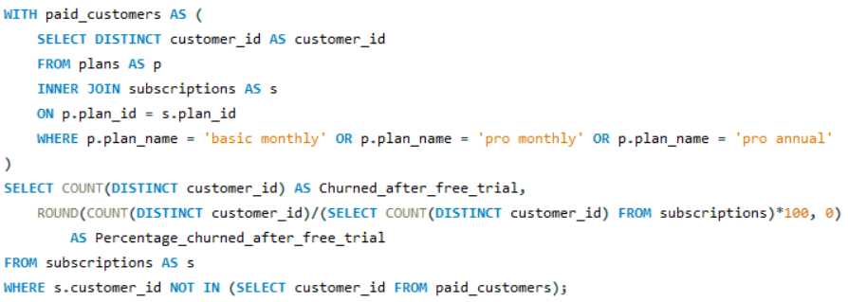
Data Analysis
Question 5. How many customers have churned straight after their initial free trial - what percentage is this rounded to the nearest whole number?
Query:
Result:

Slide 11
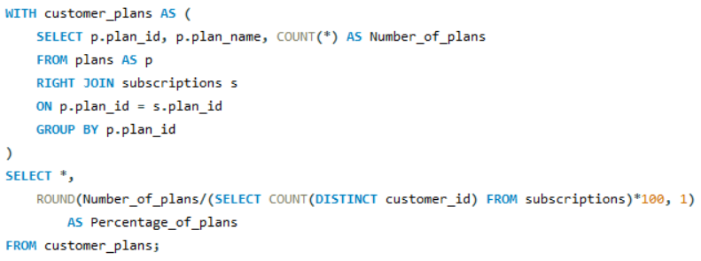
Data Analysis
Question 6. What is the number and percentage of customer plans after their initial free trial?
Query:
Result:

Slide 12
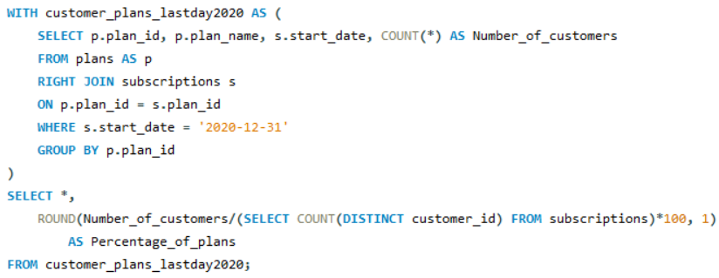
Data Analysis
Question 7. What is the customer count and percentage breakdown of all 5 plan_name values at 2020-12-31?
Query:
Result:

Slide 13

Data Analysis
Question 8. How many customers have upgraded to an annual plan in 2020?
Query:
Result:

Slide 14
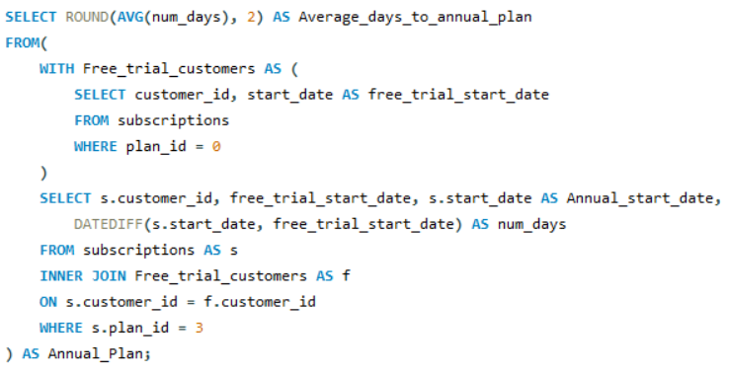
Data Analysis
Question 9. How many days on average does it take for a customer to an annual plan from the day they join Foodie-Fi?
Query:
Result:

Slide 15
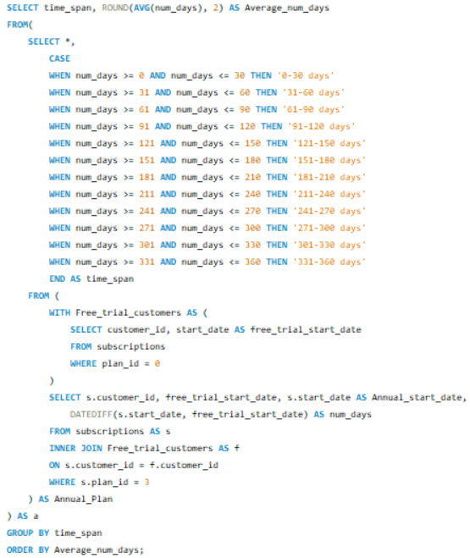
Data Analysis
Question 10. Can you further breakdown this average value into 30 day periods? (i.e. 0-30 days, 31-60 days etc)
Query:
Result:

Slide 16
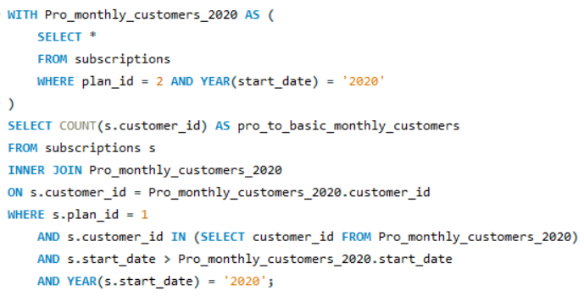
Data Analysis
Question 11. How many customers downgraded from a pro monthly to a basic monthly plan in 2020?
Query:
Result:

Slide 17
Data Insights - Summary
Foodie-fi has 1000 customers.
Highest number of trial plans were subscribed in March and lowest in February.
70 trial plans are subscribed per month on average.
30.7% customers have churned from subscriptions.
9% customers churned right after their free trial.
195 customers upgraded to an annual plan in 2020.
It takes 104.62 days on average for a customer to upgrade to an annual plan.
None of the customers downgraded from a pro monthly to basic monthly plan in 2020.

Slide 18
Recommendations
Reduce the subscription cost of basic monthly plan and give more access so that the customers don’t churn right after free trial.
Reduce the subscription cost of pro monthly plan so that the customers don’t downgrade to a basic monthly plan.
Use digital marketing to increase average number of trial plan subscriptions per month.

Slide 19
Thank you

